Slide 1
The History of Microscopes: For Dummies

Slide 2
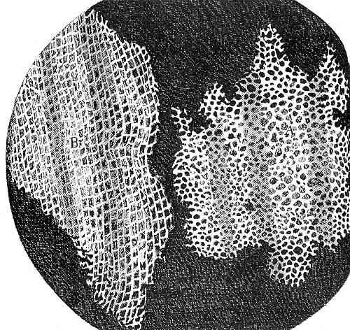
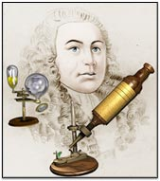
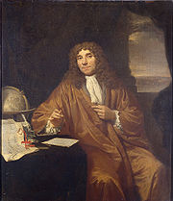
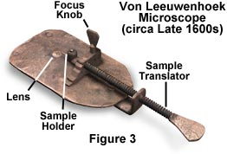
Discovery of the Cell
Robert Hooke (1665) – English scientist who looked at thin slices of cork (dead oak tree bark) under a light microscope and noticed tiny “compartments” that he named cells.
Anton van Leeuwenhoek (1700) – Dutch fabric merchant and amateur scientist developed a better microscope and observed tiny living organisms in pond water, that he named “animalcules.”
Hooke’s original drawing of cork under a microscope.
Notes:
Developed new lenses
Concade and convex lenses
Robert Hooke (1665) – English scientist and lenses grinder
Put concade and convex lenses together to magnify and create microscope
looked at thin slices of cork (dead oak tree bark) under a light microscope and noticed tiny “compartments” that he named cells (because empty → dead so organelles and cytoplasm dry up and leave strong cell wall+ made of carb –cellulose/dietary fiber ).
Credited with naming “cell” -> looked like monastery cell
Also amazing artist * drew the black and white pic
Anton van Leeuwenhoek (1700) – Dutch fabric merchant and amateur scientist
developed a better microscope
Put specimen and rotate focus knob to bring lens closer/farther
And also move specimen with sample translator
observed tiny living organisms in pond water, that he named “animalcules.”= protists
Looked at his own saliva
More bacteria in mouth than people on the earth
Called bacteria= weabeasties
In enlightenment affluent people really learned about everything thing around them

Slide 3
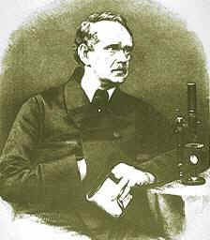
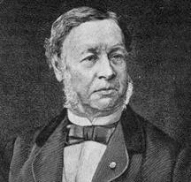
Discovery of the Cell
Matthias Schleiden (1838) - a German botanist who viewed plant parts under a microscope and discovered that plant parts are made of cells. He is considered to be the co-founder of cell theory together with Schwann, with whom he consulted.
Theodor Schwann (1839) - a German biologist who viewed animal parts under a microscope and discovered that animals were made up of cells. He extended Schleiden's cell theory in plants to animals, stating that all living things are composed of cells.
Notes:
Co founders of cell theory: (german) Matthias Schleiden +Theodor Schwann
Matthias Schleiden
- Plants make up cells
Theodor Schwann
Added to Schleiden’s theory: animals also made of cells

Slide 4
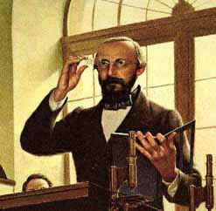
Discovery of the Cell
Rudolph Virchow (1855) - a German physician who stated that all living cells come only from other living cells.
By combining the work of all of the scientist mentioned, the Cell Theory was born…
Notes:
Also added to cell theory
Redi= scientist
One open and exposed
Developed maggots= fly larvae
One completely covered with glass
No maggots
one covered with netting
Shows no such thing as spontaneous generation= things just appeared
No idea

Slide 5
The Cell Theory – mid 1800s
Cell theory is the basis for the way that biologists study living things. Cell Theory is the most basic condition for determining if something is living.
All organisms are made of cells.
Cells are the basic unit of structure and function in living things.
New cells come from pre-existing cells.
Notes:
Of all three scientists’ ideas
Rudolph Virchow
Matthias Schleiden
Theodor Schwann
Please know this. It WILL be on test

Slide 6
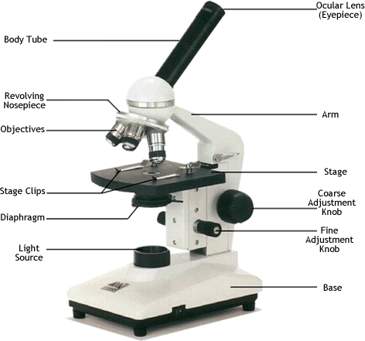
These are used to magnify objects up to about 1000 times their actual size (bacteria or larger) Used to examine living or dead specimens
Light Microscopes (LM)
Light switch
Notes:
We use this
KNOW ALL OF THESE PARTS
Turet:
Revolving nosepiece
Objective lenses
Mechanical Stage
Light source: used to be candles

Slide 7
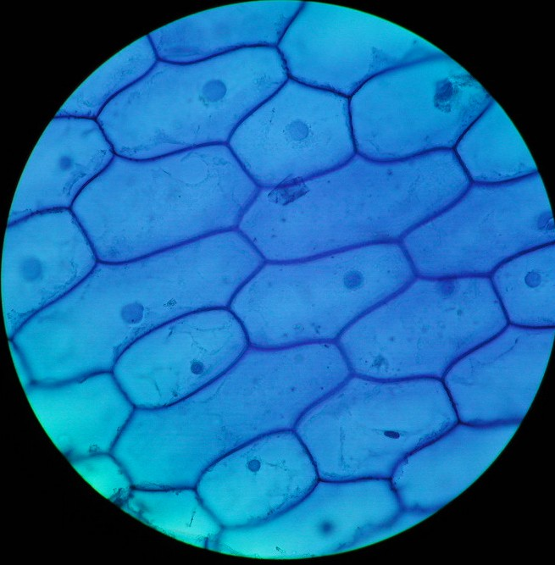
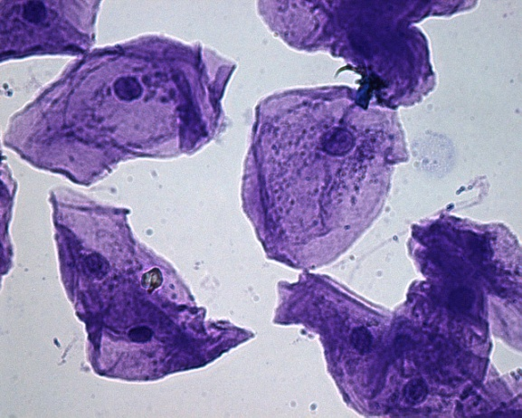
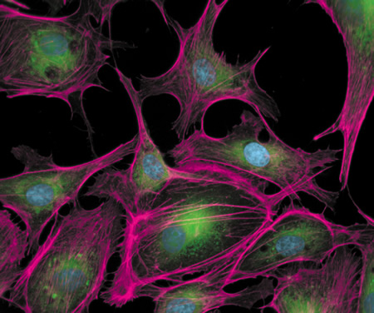
Most cells are transparent, making them difficult to see without staining them with dyes!
Onion cells stained with dye
Human cheek cells stained with dye
Arterial epithelial cells stained with fluorescent dye
Notes:
Onion: plant
Rectangular in shape
Close to each other
Easy to see cells wall
Human cheek: can see obvious nucleus
No structure: plasma membrane, not rigid

Slide 8
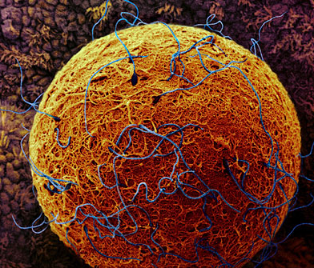
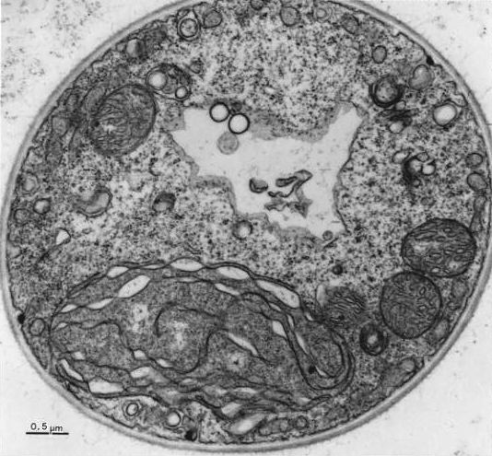
High Power Microscopes!
In the 1950s, electron microscopes were developed which used a beam of electrons instead of a beam of light.
Two Types – only view dead specimens
Scanning Electron Microscope (SEM)
Examines the surface structures of cells
Transmission Electron Microscope (TEM)
Examines the internal structure of cells
Micrograph – a photograph of the view through a microscope
Human egg (SEM)
Red algae (TEM)
Notes:
Electron microscope: allows to see much smaller things because bounces electrons instead of light
1.SEM
Look at surface
2.TEM
Trans. Light through
Look inside
Micrograph – a photograph of the view through a microscope

Slide 9
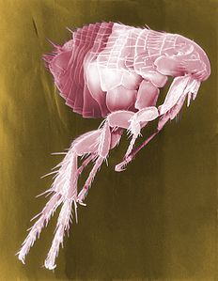
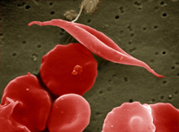
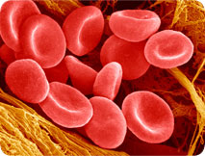
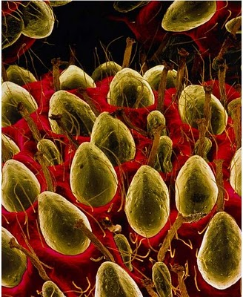
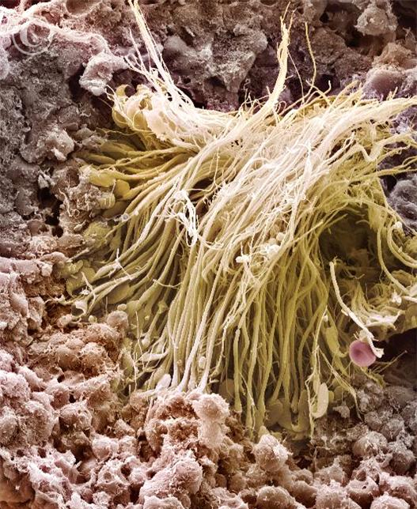
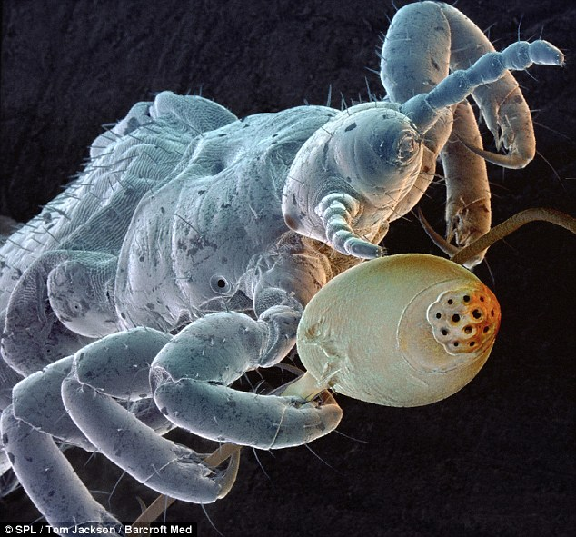
Micrograph of a sickle cell RBC
Micrograph of RBC
Micrograph of a flea
Sperm production
Surface of a strawberry
Micrograph of head louse

